Slide 1

NSG Pilkington – University of Liverpool Machine Learning Project: 04/08/2021
Dr. Peter Green
Diego Echeverria
Sarini Jayasinghe
Risk Institute,
School of Engineering

Slide 2
Re-Cap
From previous meeting:
Implementation of PoE Gaussian Process model:
Using all of dataset 3 as training.
Using concatenation of datasets 1, 2, and 3 as training.
PCA only showing key inputs identified by the GP.
Including confidence bounds.
Updating input names
Apply to MK4 and ISRA
Today:
Combining Datasets
Product-of-Experts GP
Linear Regression
Generalised Product-of-Experts GP
Next steps

Slide 3
Combining Datasets
The first 3 datasets:
21/09/2019 - 24/10/2019
07/03/2020 - 18/03/2020
25/07/2020 - 02/01/2021
All concatenated together to make a single training set.
Testing set:
19/03/2021 - 26/06/2021
Regenerator crown temperature port 4 RHS is not available for the time period 21/09/19 – 25/10/19 (set 1)
Set 3 contains ‘135 Total Firm Gas Flow Measurement’ which isn’t in the others. Have ignored for now.
Not all datasets contain ‘7532 Exit End Pyrometer Temperature Centre (PV)’. Have ignored for now.

Slide 4
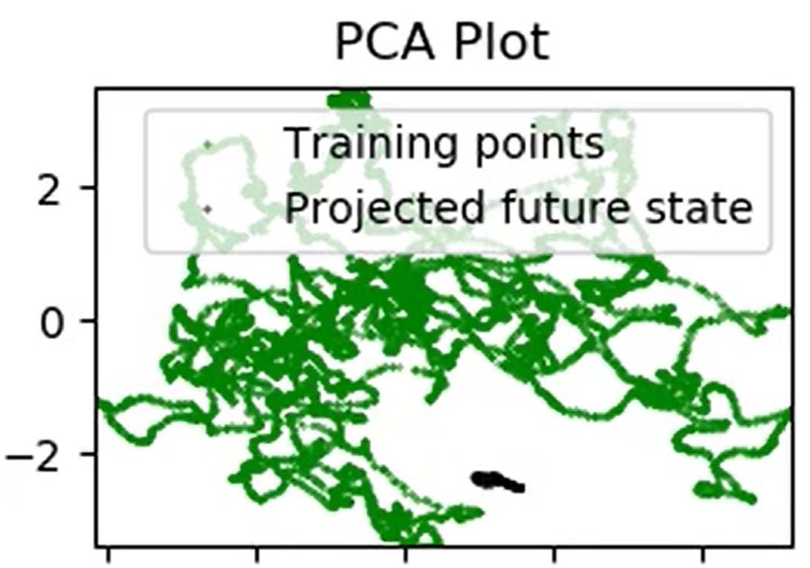
Combining Datasets
The most reliable results obtained so far have utilised key inputs that were previously identified through Gaussian Process regression. Specifically:
2922 Closed Bottom Temperature - Downstream Working End (PV)
2913 Closed Bottom Temperature - Port 1 (PV)
2918 Closed Bottom Temperature - Port 6 (PV)
2921 Closed Bottom Temperature - Upstream Working End (PV)
10091 Furnace Load
7546 Open Crown Temperature - Port 1 (PV)
7746 Open Crown Temperature - Port 2 (PV)
7673 Open Crown Temperature - Port 5 (PV)
7483 Open Crown Temperature - Port 6 (PV)
10271 Open Crown Temperature - Upstream Refiner (PV)
All of the following PCA plots correspond to these inputs

Slide 5
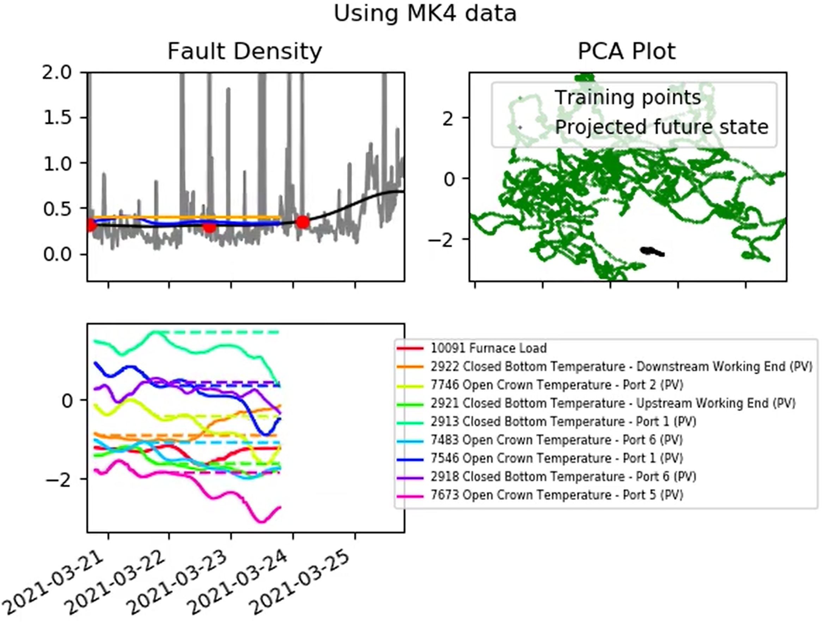
Product-of-Experts Gaussian Process
PoE GP implemented and tested
Deployed on 15,000 training points, using 20 “experts”
ANN omitted for now for the sake of simplicity
“MK4 test video reduced inputs.mp4”
Unexpectedly, the PoE-GP only produces a flat line(!)
Last week we saw a standard GP, trained on a subset of this data, performing very well.
Changing no. experts, scanner type, inputs (and more) doesn’t seem to change this behaviour.
Will return to this but first – with this large amount of training data the linear regression model is looking better.
Have taken a closer look for this reason.

Slide 6
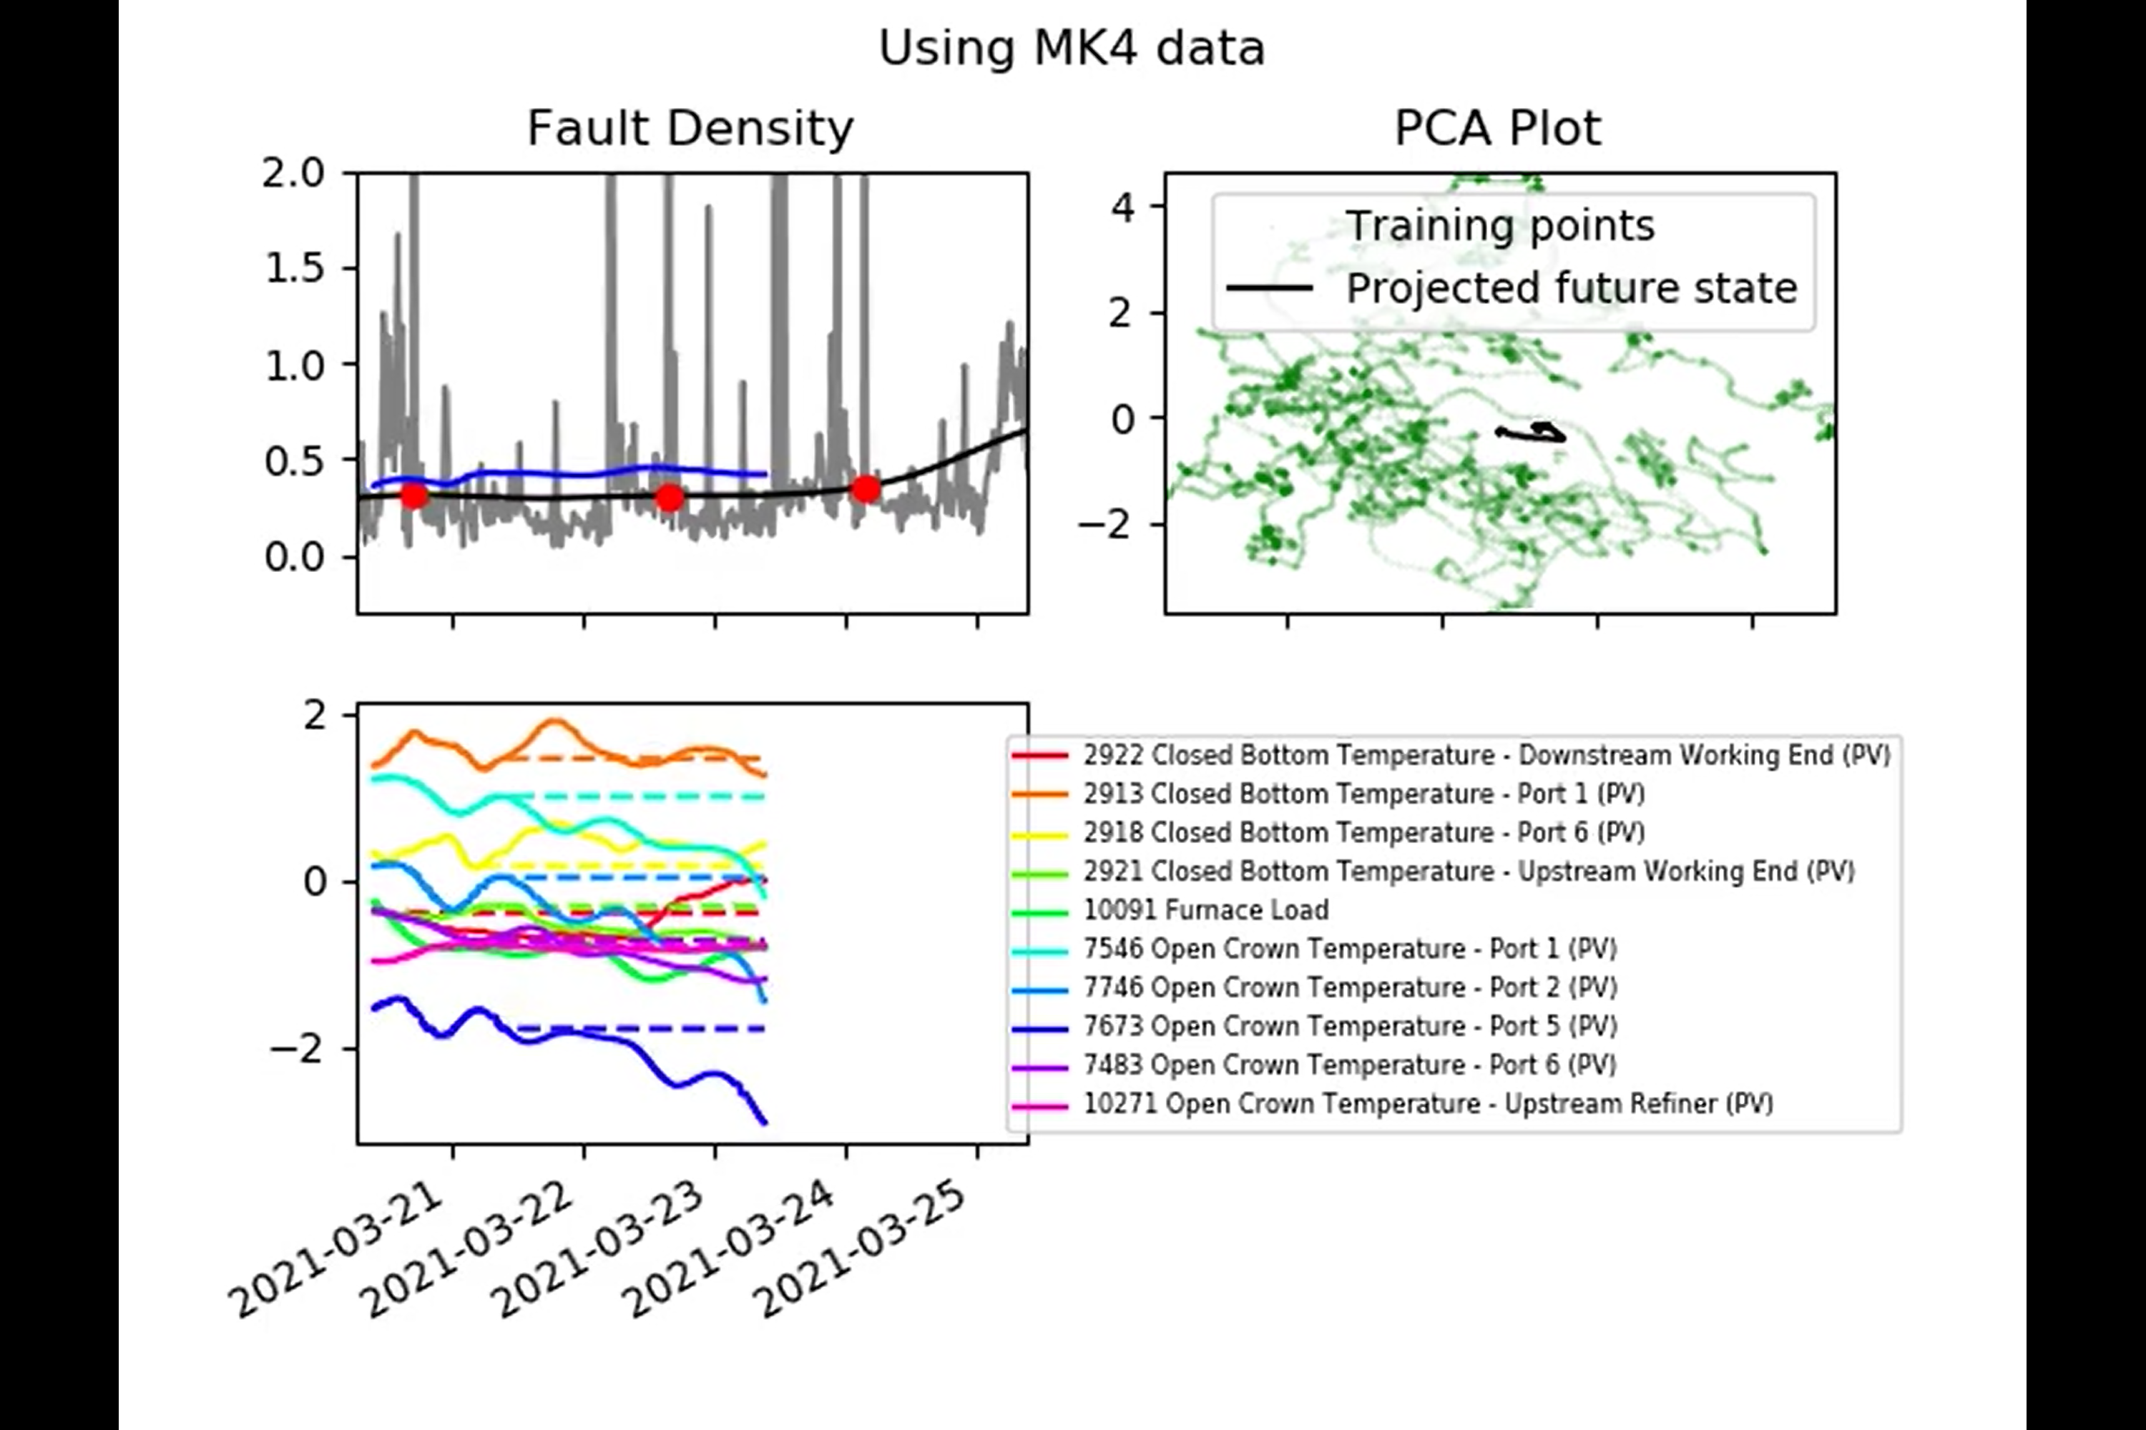
Linear Regression
Previously agreed that we didn’t necessarily want a model that updated its parameters, as it would lose memory of key events.
Turned off the ‘online updating’ aspect of the linear regression model.
Also introduced some transparency to the PCA points to help us see where concentrations of points are.

Slide 7
Linear Regression
Previously agreed that we didn’t necessarily want a model that updated its parameters, as it would lose memory of key events.
Turned off the ‘online updating’ aspect of the linear regression model.
Also introduced some transparency to the PCA points to help us see where concentrations of points are.

Slide 8
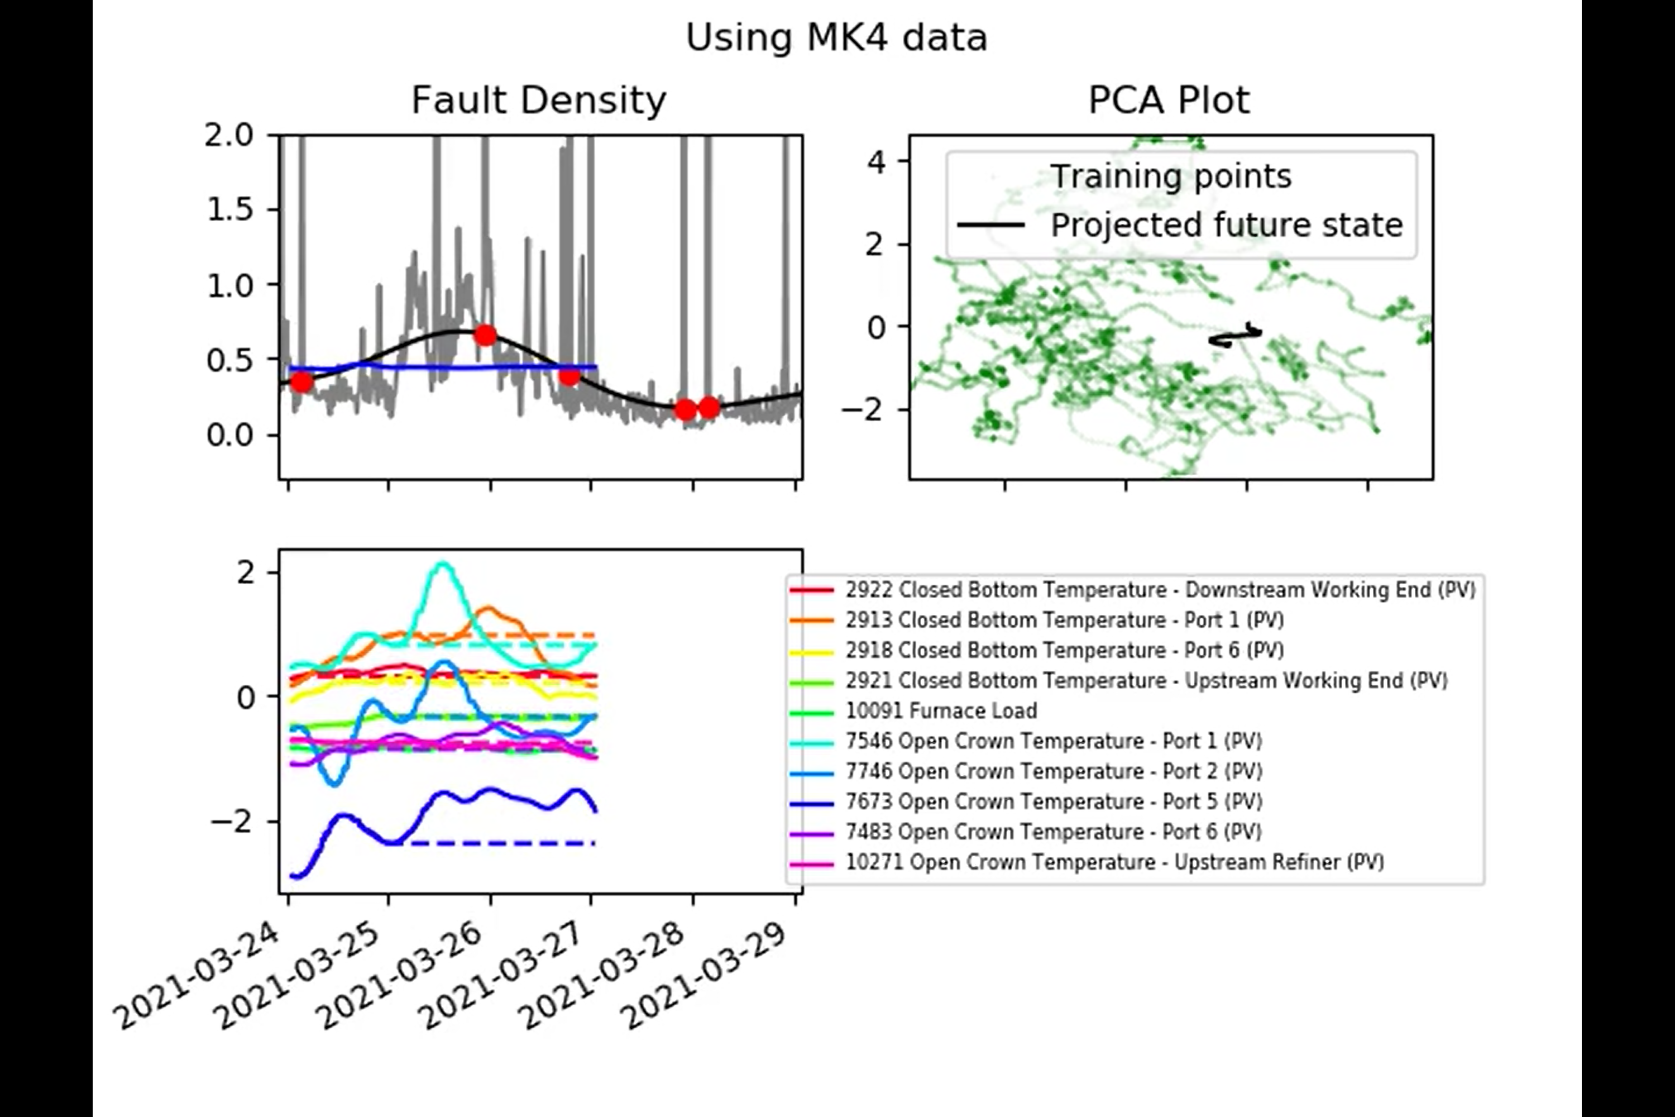
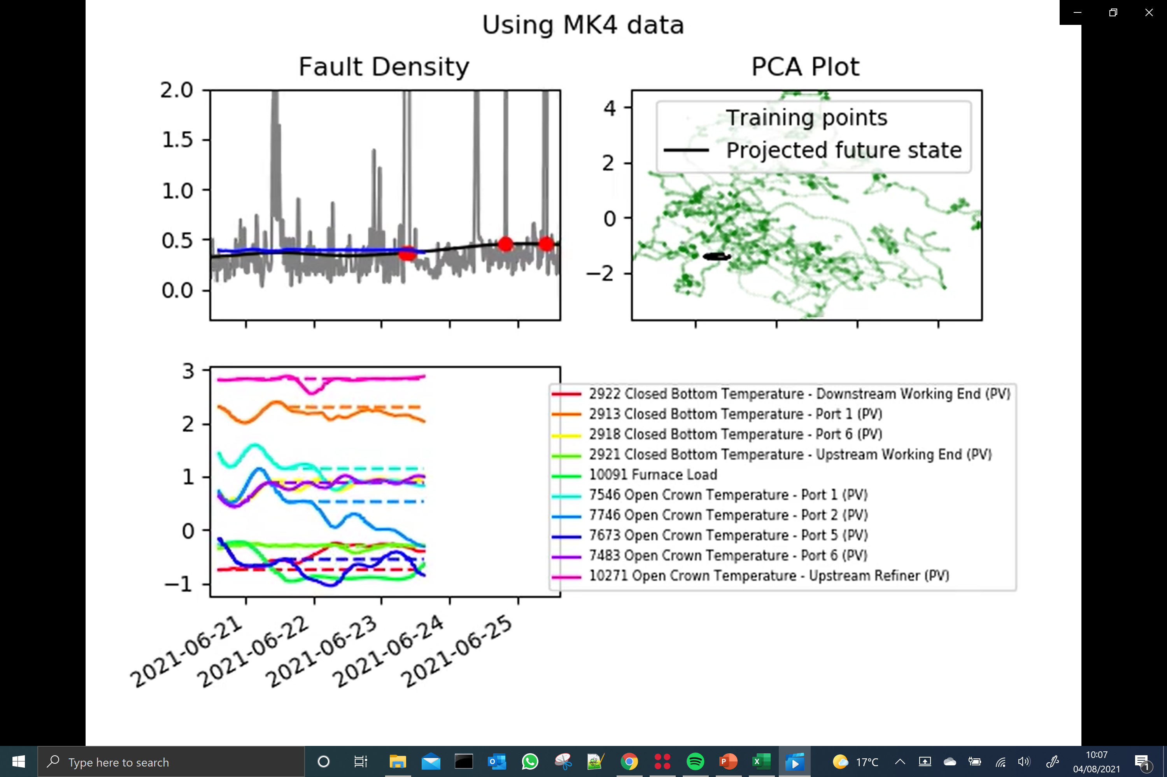
Linear Regression
“MK4 test video static lr.mp4”
Some poor regions outside of the training data.
But there are also some promising regions within the training data.
May be worth providing online Linear Regression results as part of the deep-dive review?
Other models to still be included.

Slide 9
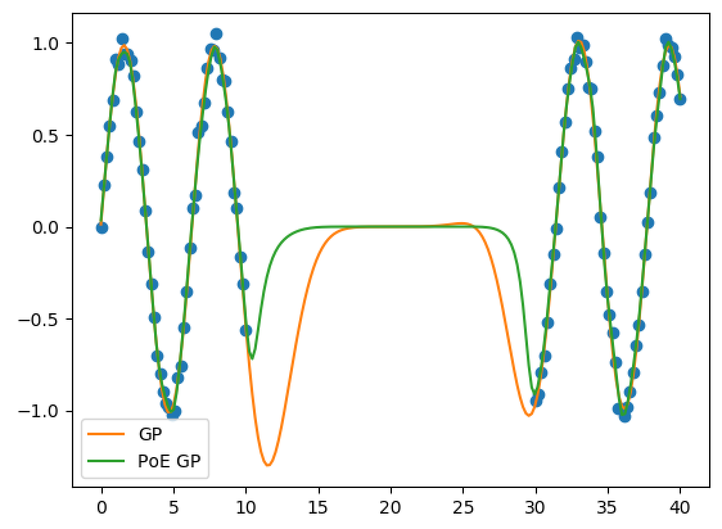
Generalised Product-of-Expert Gaussian Processes
Eventually realised: when moving away from training data, the PoE model ‘dies away’ faster that a standard GP.
This is as a result of multiplying together predictions that are close to zero.
Not necessarily obvious from the literature.
“A shortcoming of this model is that with an increasing number of GP experts the predictive variances vanish … which leads to overconfident predictions” [1]
Doesn’t note how using many experts can reduce the model’s ability to interpolate.
[1] Deisenroth, M., & Ng, J. W. (2015, June). Distributed gaussian processes. In International Conference on Machine Learning (pp. 1481-1490). PMLR.

Slide 10
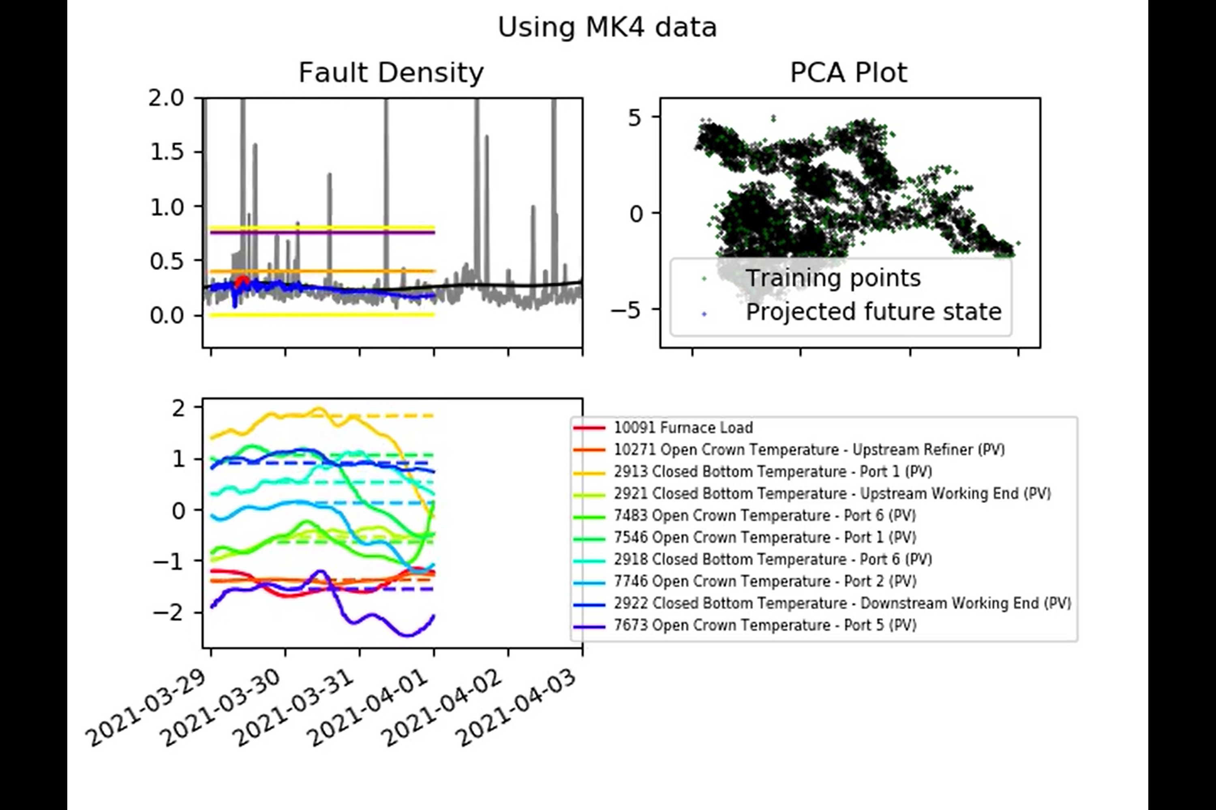
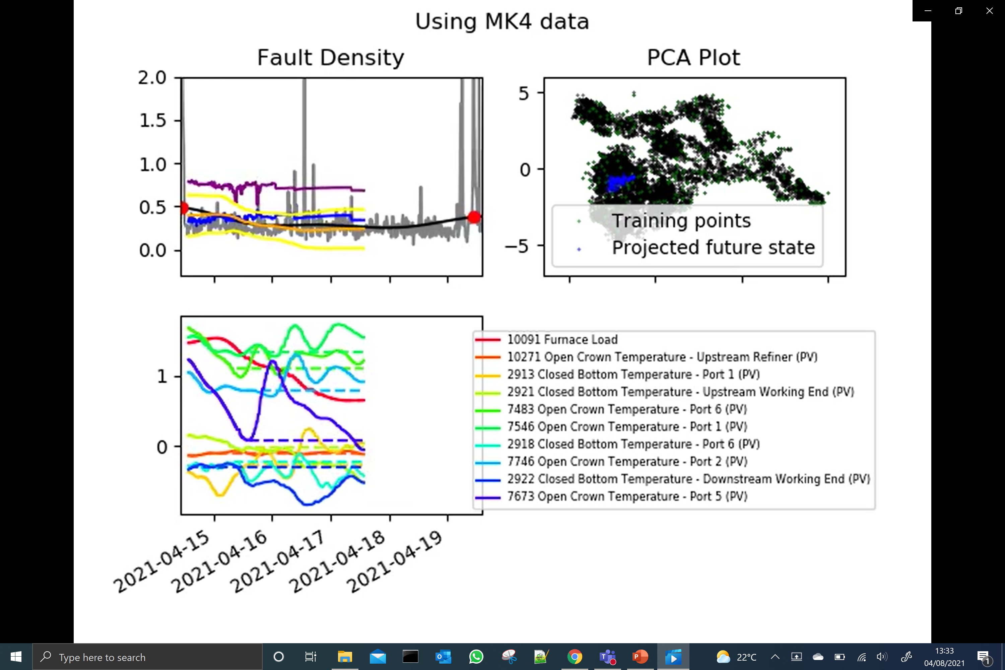
Generalised Product-of-Expert Gaussian Processes
The Generalised PoE GP [2] was going to be implemented anyway, as it’s supposed to provide more reliable confidence bounds.
Each GP is multiplied by a “predictive power” factor before the product of GPs is calculated.
Predicted power essentially relates to the difference between:
The predictive variance of the untrained model (before it has seen any data i.e. the “flatlining”)
The predictive variance of the trained model
This should remove experts with low predictive power from having any influence on the predicted mean and standard deviation.
[2] Cao, Y., & Fleet, D. J. (2014). Generalized product of experts for automatic and principled fusion of Gaussian process predictions. arXiv preprint arXiv:1410.7827.

Slide 11
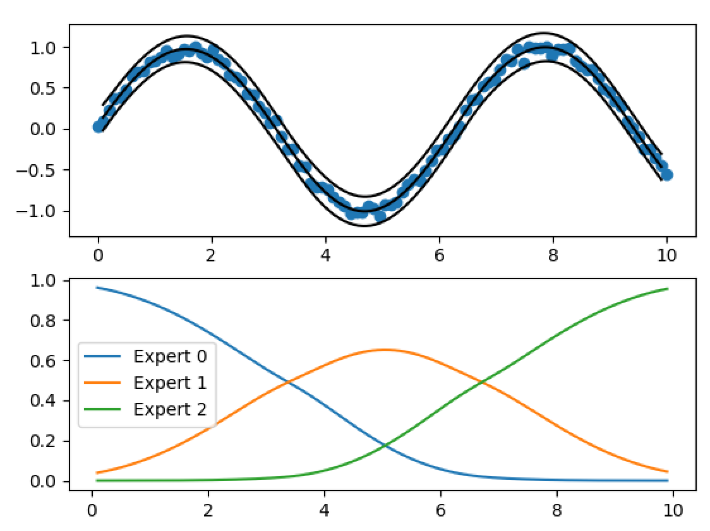
Generalised Product-of-Expert Gaussian Processes
Development code currently being tested on a 1D problem:
Confidence bounds looking OK.
Predictive power

Slide 12
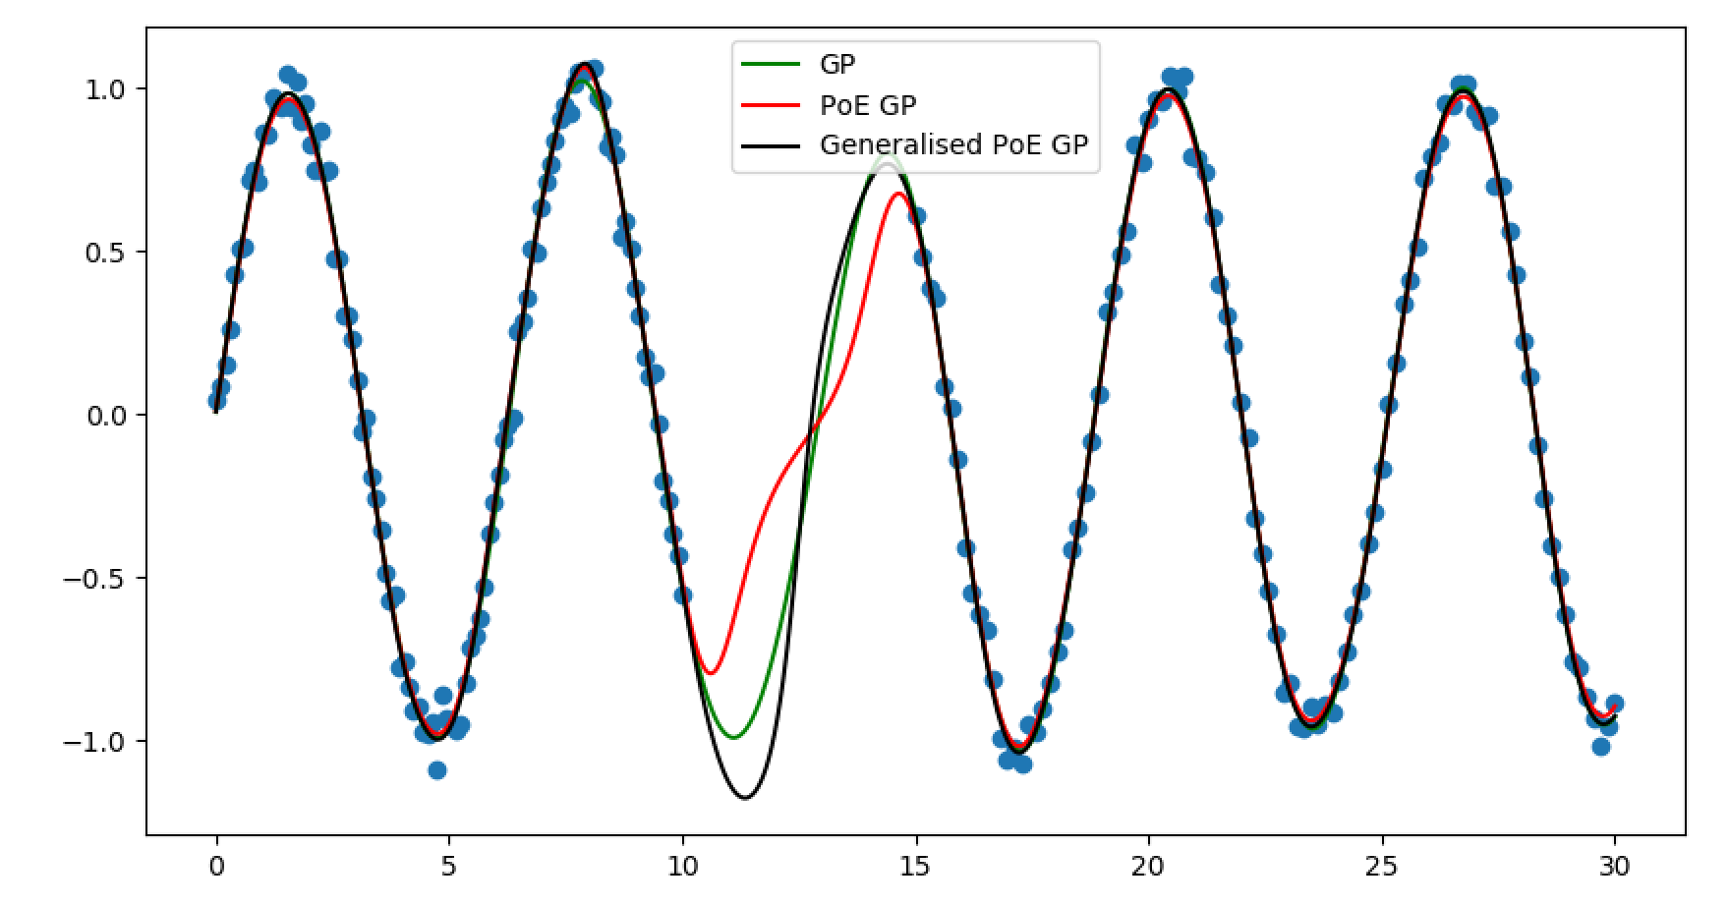
Generalised Product-of-Expert Gaussian Processes
Initial tests show that the Generalised PoE GP is closer to a standard GP when interpolating across a large ‘gap’ in the training data:

Slide 13
Next Steps
From previous meeting:
Implementation of PoE Gaussian Process model:
Using all of dataset 3 as training.
Using concatenation of datasets 1, 2, and 3 as training.
PCA only showing key inputs identified by the GP.
Including confidence bounds.
Updating input names
Apply to MK4 and ISRA

Slide 14
Next Steps
From previous meeting:
Implementation of PoE Gaussian Process model:
Using all of dataset 3 as training.
Using concatenation of datasets 1, 2, and 3 as training.
PCA only showing key inputs identified by the GP.
Including confidence bounds.
Updating input names
Apply to MK4 and ISRA

Slide 15
Next Steps
From previous meeting:
Implementation of PoE Gaussian Process model:
Using all of dataset 3 as training.
Using concatenation of datasets 1, 2, and 3 as training.
PCA only showing key inputs identified by the GP.
Including confidence bounds.
Updating input names
Apply to MK4 and ISRA
Next steps:
Updating inputs names
Process ISRA data
Linear regression only videos
MK4
ISRA
Generalised PoE GP only videos
MK4
ISRA

Slide 16
Next Steps
From previous meeting:
Implementation of PoE Gaussian Process model:
Using all of dataset 3 as training.
Using concatenation of datasets 1, 2, and 3 as training.
PCA only showing key inputs identified by the GP.
Including confidence bounds.
Updating input names
Apply to MK4 and ISRA
Next steps:
Updating inputs names
Process ISRA data
Linear regression only videos
MK4
ISRA
Generalised PoE GP only videos
MK4
ISRA
More of an unknown but will give us confidence bounds too.
There is a 3rd option too, though not looked at it in detail yet.

Slide 17
Thank you for your attention. ANY QUESTIONS?

